Slide 2
ONLINE COMMERCE
Direct to Consumer Sales
Commercial Sales
Warranty & Sales Support
Direct to Consumer
Donations

Slide 3
Brand New, Fully Redesigned
USED-PCS.COM
ONLINE STORE
We have completely re-designed our Used-PCs.com online store. The new look goes along with many new products but the strong customer support has stayed the same.

Slide 4
GLOBAL MARKET – GROWING DEMAND IN SECONDARY MARKET
Equipment dealers around the world offer their customers new and pre-owned solutions to provide the highest quality at the best price. Customers value high quality last generation equipment because they get ‘good enough’ equipment for a fraction of the new price. Global Resale partners with manufacturers, resellers, and leasing companies to source large volumes of retired and replaced equipment, and sells to the best equipment dealers and resellers. As a global market maker, we deliver value to our suppliers and customers with quality execution.

Slide 5
A MARKET TRANSFORMING
28+
Billion
10B+
2015
Internet of Things
28+ Billion by 2020
Cloud
10+ Billion
1B+
2010
Mobile
1+ Billion
100+ Million
Windows PC Clients
100M+
2000
Businesses liquidate billions of dollars of equipment every year. Selling it to the right buyer, at the right price, in the right market can be the difference between recovering book value or impairing the assets.

Slide 6
Who We Are
Supply Chain Experts
Global Market Makers & Traders
Great Team
Online Merchants
Lean Operators
Innovative & Flexible Solutions
Robust Reporting & Analytics
Deep Reverse Logistics Network

Slide 7
MAXIMIZING EQUIPMENT VALUE - MULTICHANNEL
Retail
Direct commercial, Consumer Sales, Employee Sale and Donations
02
Resellers
Authorized dealers that provide affordable solutions on last generation equipment
03
Wholesale
Huge Global Customer Base
04
Service Parts
Parts used for warranty service and repair
05
Open Market Parts
Parts that are used to rebuild other machines
Global Resale has built a multi-channel distribution model to achieve the highest recoveries on last generation equipment.
06
Recycling
We partner with the worlds largest commodities recyclers to recover value from scrap machines. We use the best in class quality teardown processes.

Slide 8
Distribution and Remanufacturing
HQ – 120,000 feet in Austin Texas
East Coast United States – December 2015

Slide 9
REPAIR
Screen repair
Any screen 4” – 60”
Clean Room. 5 PPM
Glass, Digitizer, Polarizer, Light Guide Panel, Backlight
CRU & FRU Parts Replacement
Reconfiguration
Solving common defect problems to maximize resale values

Slide 10
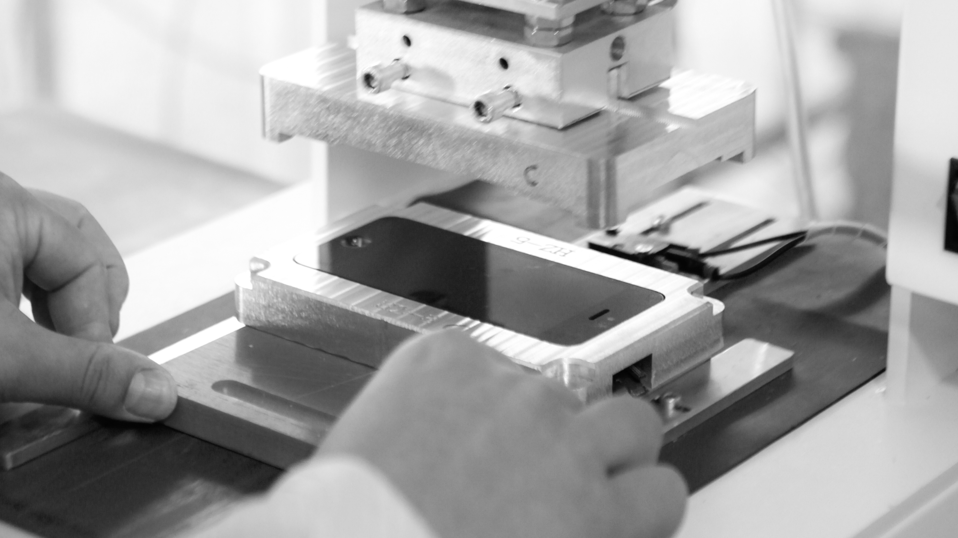
PARTS HARVESTING
Parts are resold, reused and recycled depending on demand. Parts are harvested and used to their Maximize Value
Warranty & Service
Open Market

Slide 11
WHOLESALE – GLOBAL NETWORK
MULTI
LANGUAGE
MULTI
CURRENCY
WARRANTY & SUPPORT
LARGE VOLUMES
AREA SPECIALISTS

Slide 12
EQUIPMENT EXPERTISE
Leased & Owned
Residual Value Recovery
Open Market
Arbitrage Supply
Global Planning
IT
Mobility
CE
Medical
Semiconductor
Test
Imaging
‘Smart’ Devices

Slide 13
WORKING WITH OUR PARTNERS
REVERSE LOGISTICS
ASSET
ACCOUNTING
INVENTORY &REBUILD
PLANNING
RESALE
Serialized Inventory Reconfiguration
Repair – L1,2,3
Refurbish
Imaging
Bids
FMV
Onsite Appraisal
RFP & RFQs
Repair Estimates
Onsite Collection
Branch, Campus, Distribution
Dedicated Truck
Import / Export
Buy, or Consign
Retail
Wholesale
Parts / Salvage
Serialized Items
Condition Report
Service Fees
Final Buy or Sell
Discrepant Items
1-3
2-15
3-30
5-45
Days

Slide 14
THANK YOU
?

